Slide 1
Employee Data Analysis using Excel
STUDENT NAME: SHARUMATHI.G
REGISTER NO: 122201951 asunm1351unm135122/cp/112
DEPARTMENT:B.COM CORPORATE SECRETARYSHIP
COLLEGE: CHEVALIER T.THOMAS ELIZABETH COLLEGE FOR WOMEN

Slide 2
PROJECT TITLE
Employee Performance Analysis using Excel

Slide 3


AGENDA
Problem Statement
Project Overview
End Users
Our Solution and Proposition
Dataset Description
Modelling Approach
Results and Discussion
Conclusion
3/21/2024 Annual Review

Slide 4

PROBLEM STATEMENT
For Accomplishment
For Salary Increase
Thoughtfully evaluates various perspectives and strategies before making decisions.
Consistently demonstrated a strong aptitude for solving complex problems with efficiency

Slide 5

PROJECT OVERVIEW
Analyzing employee performance by taking into account factors such as gender, performance scores, and ratings to identify trends and patterns across different employee categories (high, medium, low). Compare their strengths and weaknesses, and recommend actionable goals for improvement.
.

Slide 6

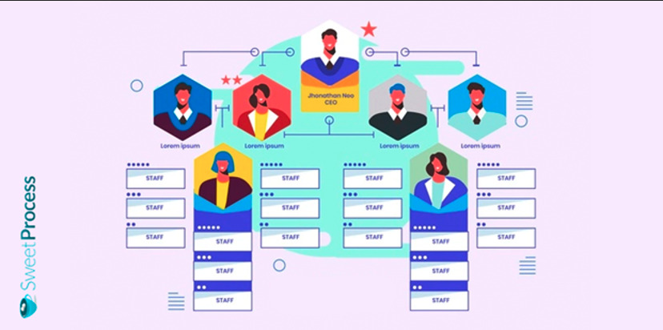

WHO ARE THE END USERS?

Slide 7

OUR SOLUTION AND ITS VALUE PROPOSITION
Conditional Formatting: Absence
Filter: Eliminate
Formula: Efficiency
Pivot: Overview
Graph: Data Representation

Slide 8
Employee Data Description
First Name
Last Name
Gender
Business Unit
Performance Score
Current Employee Rating
Credit Rating Performance

Slide 9

THE "WOW" IN OUR SOLUTION
PERFORMANCE LEVEL = =IFS( F2 >= 4, "Good", F2 = 3, "Average", F2 <= 2, "Bad" )
3/21/2024 Annual Review
9

Slide 10
MODELLING
DATA COLLECTION
GAGGLE TO DOWNLOAD THE DATA
FETURE COLLECTION
Employee Status
Employee Type
Gender Code
Performance Score
Current Employee Rating
DATA CLEANING
MISSING VALUE IDENTIFY
MISSING VALUE FILTER
PERFORMANCE LEVEL
Bar , Pie Diagram, Line Chart
SUMMARY
10

Slide 11
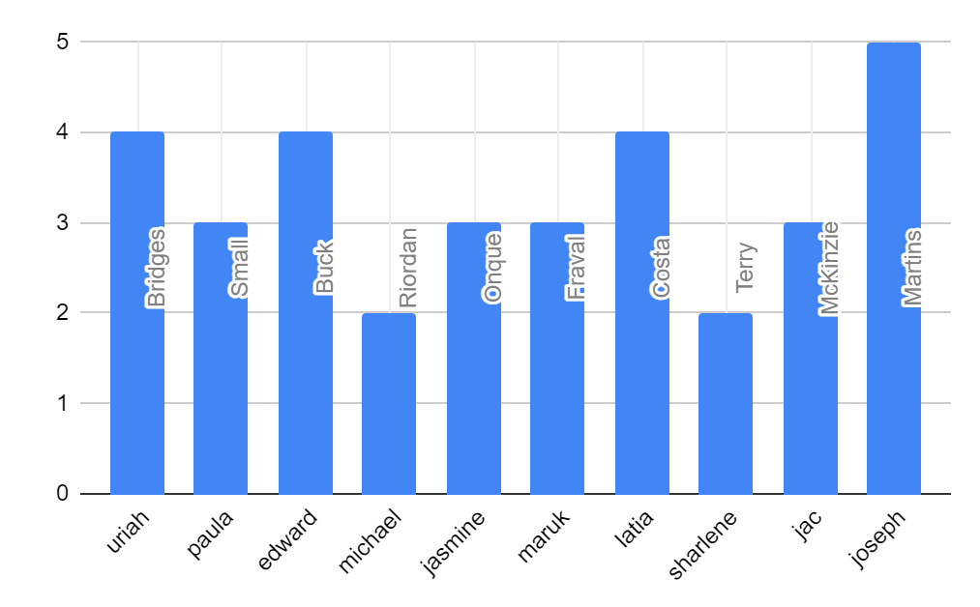
RESULTS
11

Slide 12
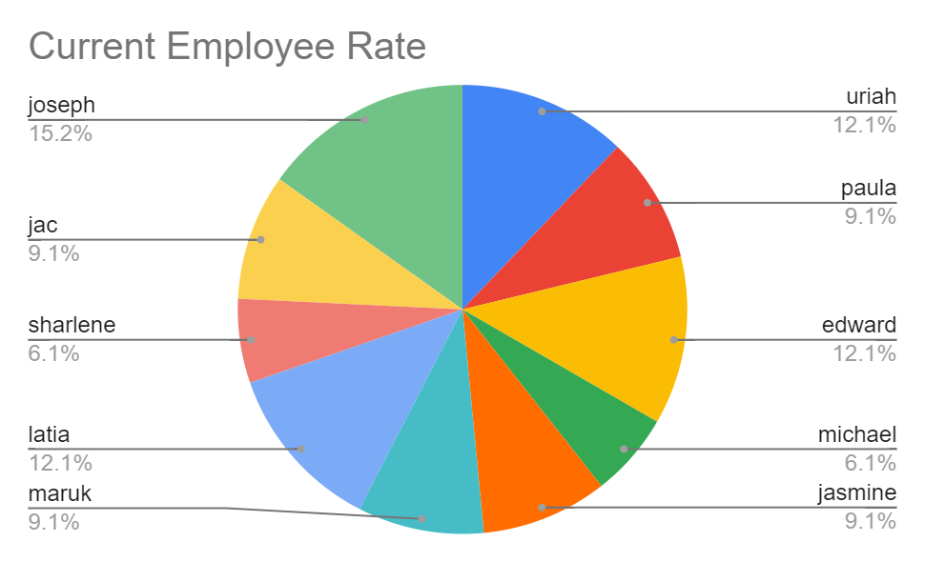
RESULTS

Slide 13
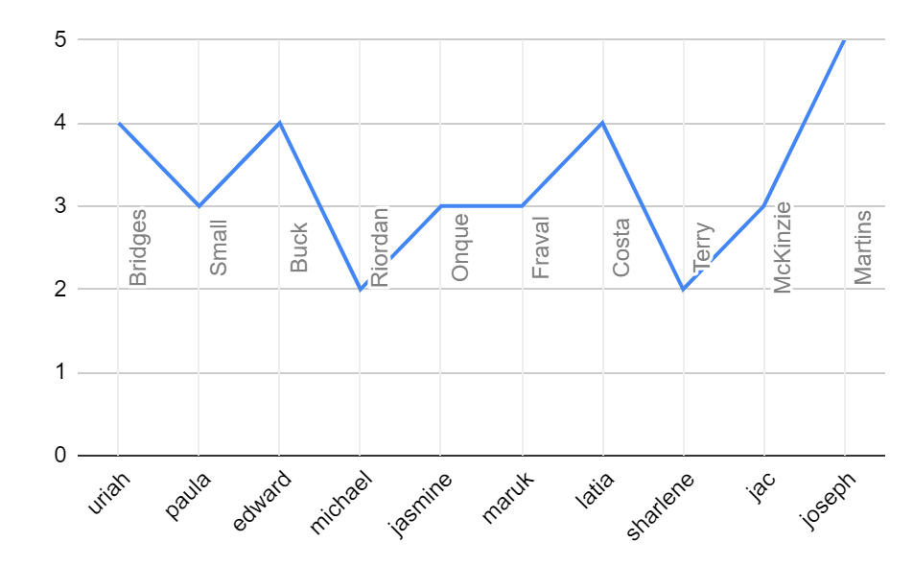
RESULTS

Slide 14
conclusion
By evaluating employee performance, it is observed that the number of employees with average performance of Good, Bad, and Average. To address this, we can assign tasks of varying levels based on their performance and work. Motivating them effectively is essential for achieving better outcomes.

